Slide 1
Alternative Energy

Slide 2
Nonrenewable?
Will not be reproduced within our lifetime.
There is a finite amount of these resources.
Coal
Oil
Natural Gas
Metals
Minerals

Slide 3
Renewable?
These sources of energy can be replaced within our lifetime.

Slide 4
Why alternative energy sources?
Eventually, nonrenewable fossil fuels will be used up.
We need to look at our alternative, renewable resources to use for energy.
Renewable = Alternative…. Most of the time.

Slide 5
So, what are some alternative energy sources?
Wind
Hydroelectric
Geothermal
Solar
Biofuels
Nuclear: non-renewable energy source!

Slide 6
Wind
Energy created from moving air
Wind is a form of solar energy
Mainly caused by uneven heating of the atmosphere by the sun.
Opposite of fan- instead of using electricity to make wind, it uses wind to make electricity.

Slide 7
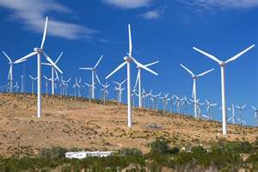
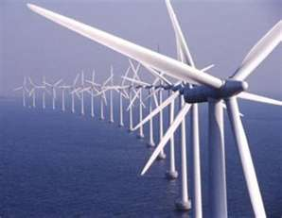

Slide 8
Hydroelectric
Energy created from moving water.
The water drives turbines (wheels), which drive generators to produce electricity.
Major form of energy being used today.

Slide 9
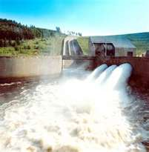
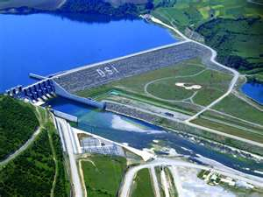
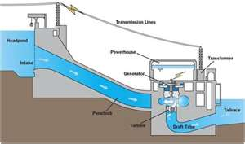

Slide 10
Geothermal
Energy from Earth’s heat.
Rocks and water absorb heat from magma near the surface.
The deeper you go underground, the hotter the rocks and water are.
Geothermal energy can come to the surface in the form of volcanoes, hot springs, geysers, etc.
Used to heat buildings through heating systems. Hot water can be piped directly into buildings and used for heat.

Slide 11
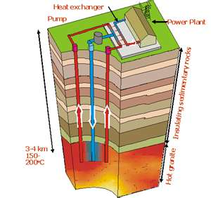
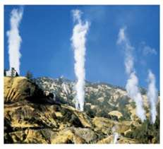

Slide 12
Solar
Energy from the sun by use of photovoltaic cell.
Solar collectors are easy to build, but expensive.
Sun’s energy makes electrons flow = current
Heat collected from the cell can be stored and used to heat homes or water.

Slide 13
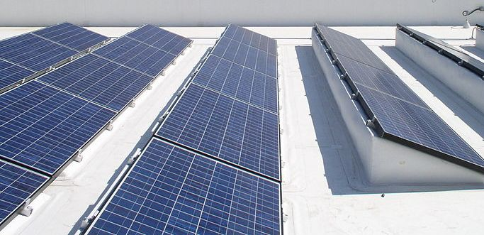
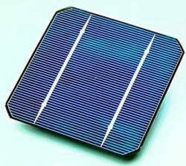
photoelectric cells

Slide 14
Biofuel/ Biomass
Made from crops that can’t be replanted or organic waste matter.
Most popular type = ethanol (made from corn)
Often mixed with gasoline to create fuel for vehicles. 10% ethanol/ 90% gasoline
Biodiesel is a form of biofuel produced from new or used vegetable oils and animal fats.

Slide 15
Ethanol – most popular

Slide 16
Nuclear Power
NOT A RENEWABLE RESOURCE!!!
16% of the world’s electrical energy is produced by nuclear power.
Concerns:
Limited amount of uranium needed to power plants.
Dangerous, health concerns

Slide 17
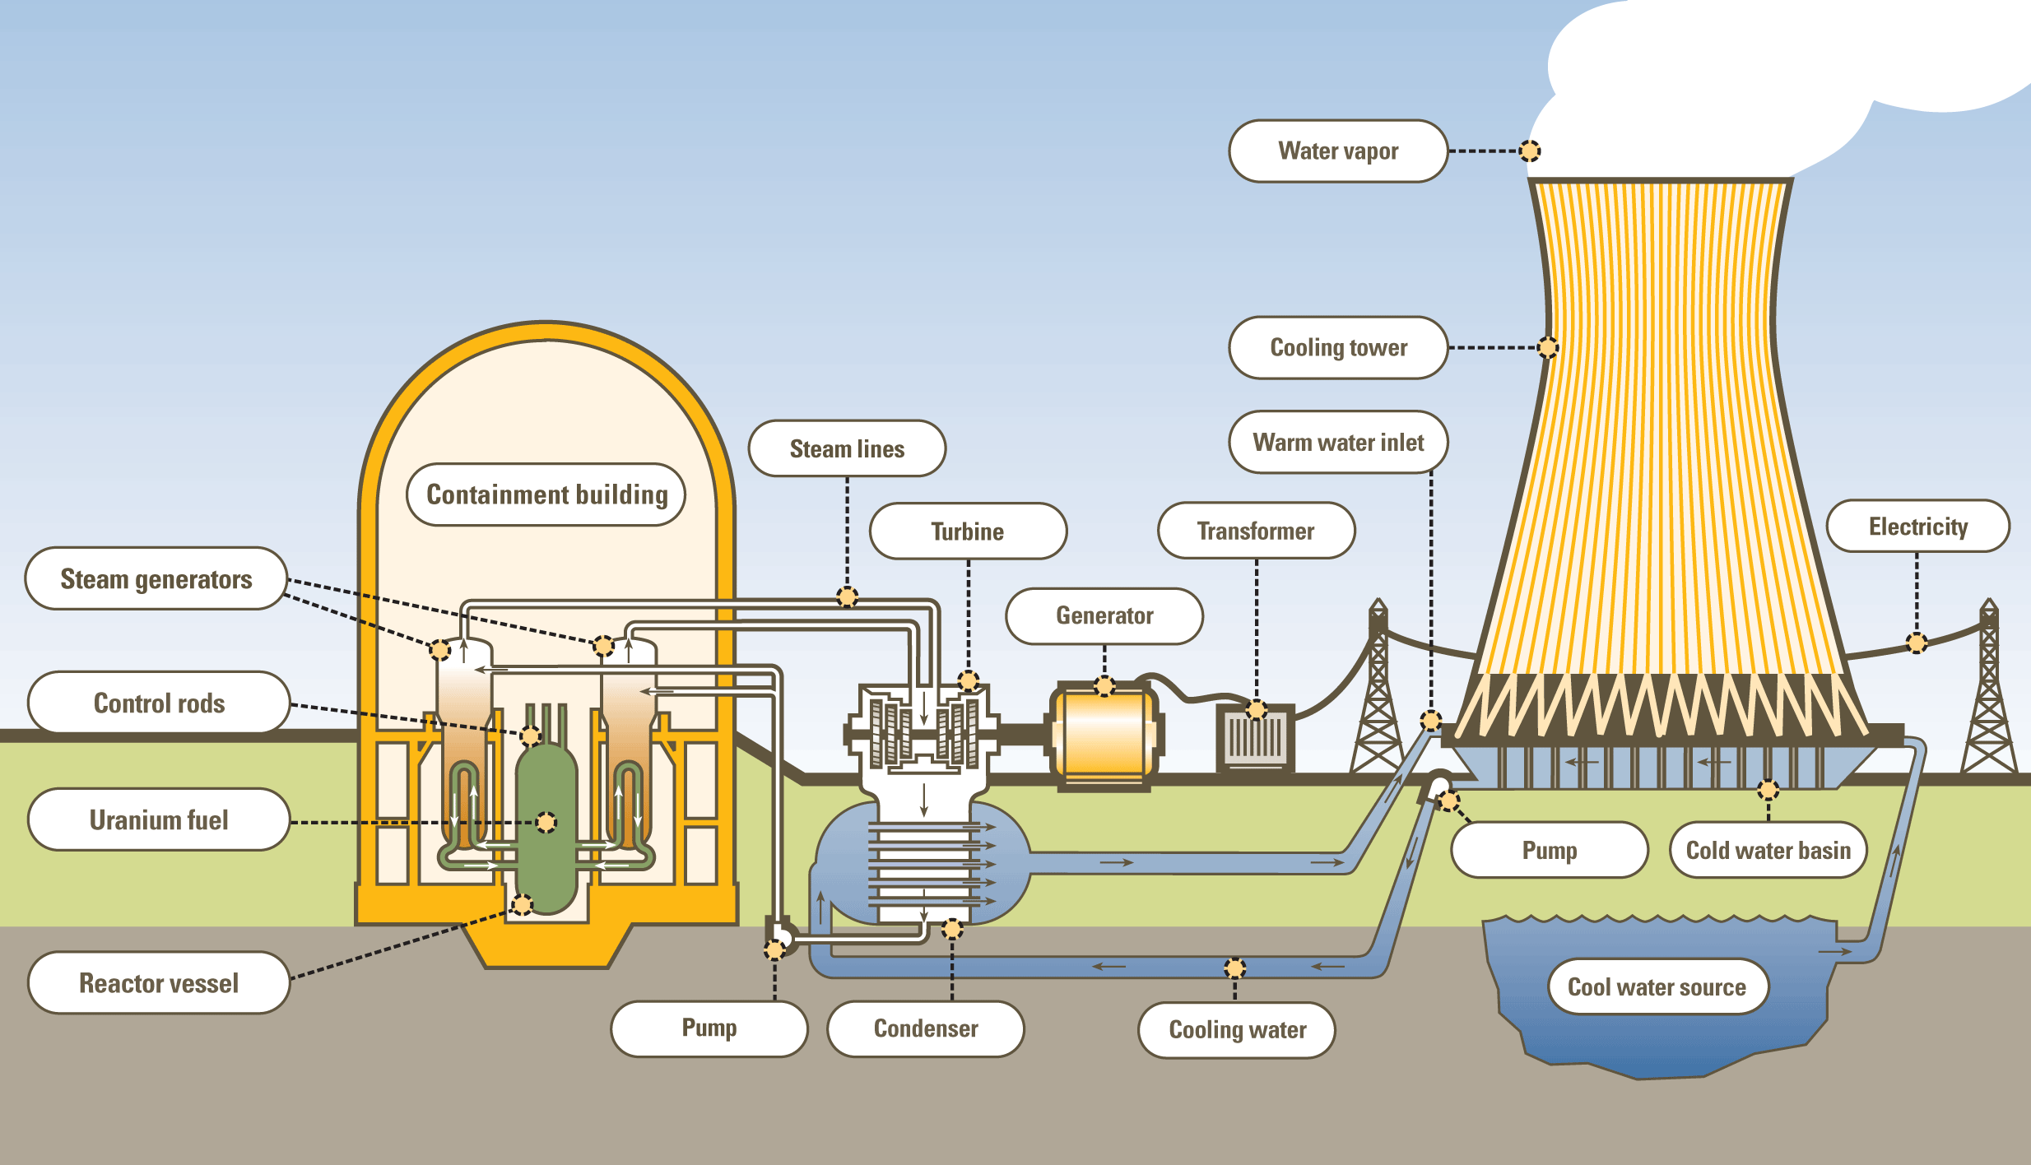
Nuclear Power

